Slide 1
ONLINE SHOPPING SYSTEM
GROUP - D

Slide 2
PROJECT MEMBERS:
SWAPNENDU PAL – (31001220008)
ROHAN PODDER – (31001220010)
PROVAT NAGA – (31001220018)
SHEIKH ABDUR ROHIT – (31001220021)
ROHAN HANSDA – (31001220023)
AVIJIT MONDAL – (31001220033)
PRADIPTA SHOW – (31001220036)
SANDIPAN ROY – (31001220042)

Slide 3
OBJECTIVES :
. Manage the shopping details: The whole system of online shopping manage the detail of each shopping done by the customers. They extract the product details of what consumers shopped.
. Manage the payment details: In online shopping, customers get many options for mode of payments. Websites give them the option of online payment through debit or credit cards. Customers have also the option of net banking or cash on delivery payment option. It is the objective of an online shopping system to manage all the payment details of each product.

Slide 4
OBJECTIVES :
. Generate the information of customers and products: Online shopping system manages the whole information about the customers and the purchased products.
. Reduce the cost of management: Online shopping or digital shopping help in reducing the management cost of products.

Slide 5
CHARACTERISTICS OF THE PROJECT:
USER :
. Must have an account and a unique password to log in the online shopping site.
. Can see the available stock of products
. Can add a product to cart.
. User can logout at any point of time.

Slide 6
CHARACTERISTICS OF THE PROJECT:
ADMIN :
. Can see the personal details of the users.
. Can change the personal details for security purposes if they need.
. Can manage the whole database of the shopping site.

Slide 7
METHODOLOGY

Slide 8
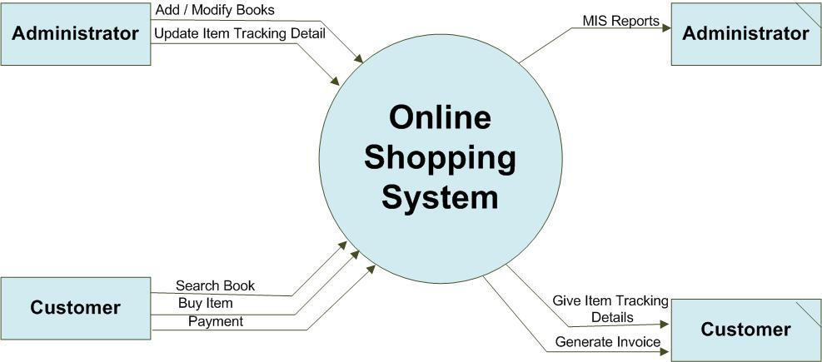
LEVEL 0 DFD

Slide 9
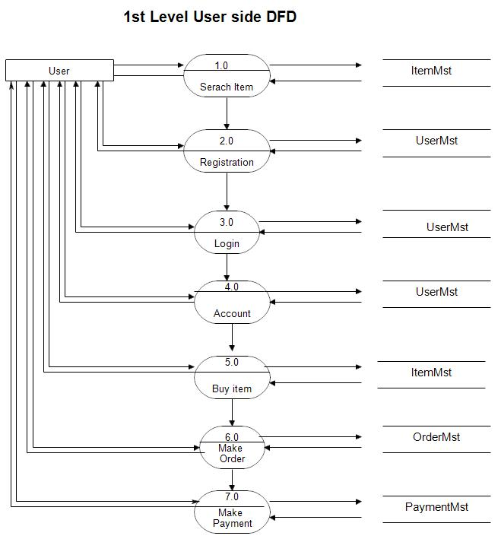
LEVEL 1 DFD

Slide 10
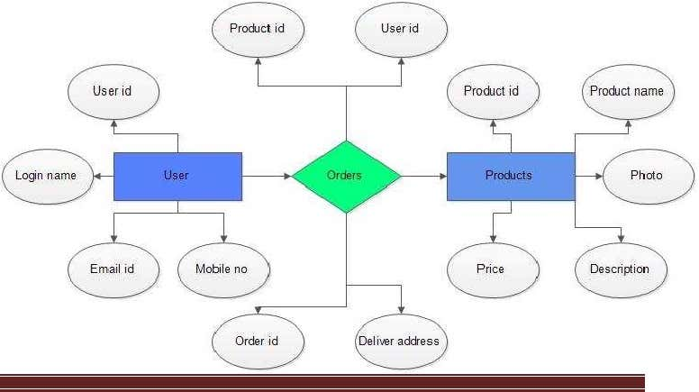
E-R DIAGRAM

Slide 11
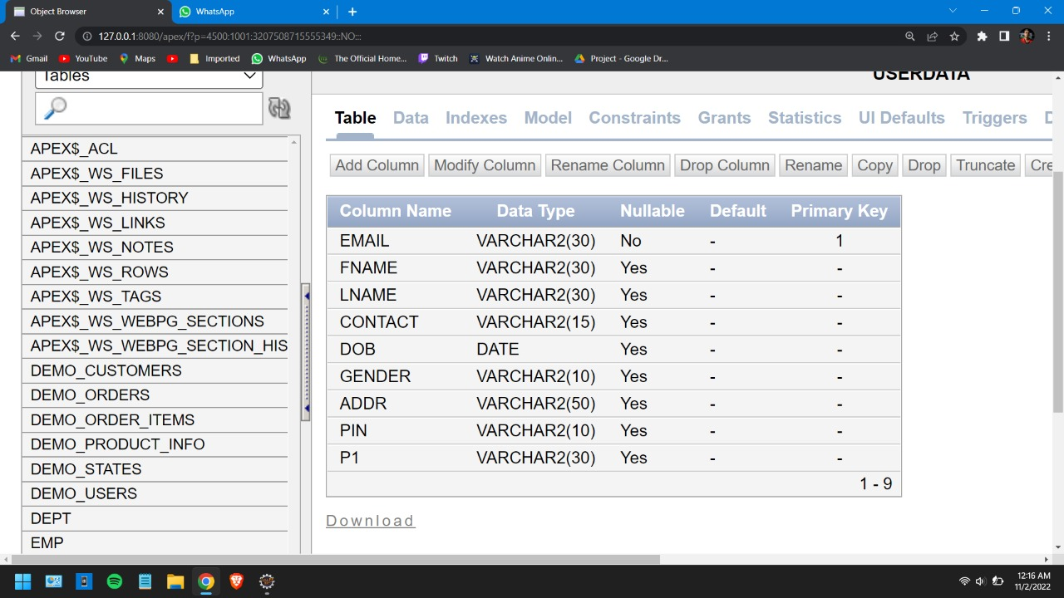
TABLES
USERDATA:

Slide 12
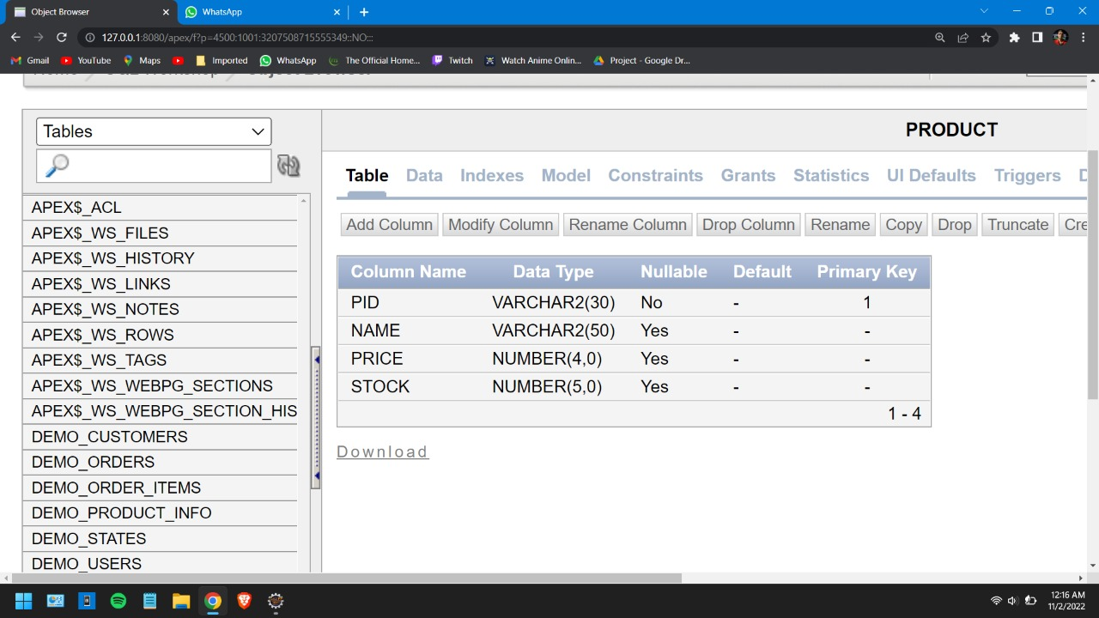
TABLES
PRODUCT

Slide 13
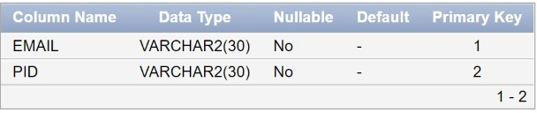
TABLES
CART :

Slide 14
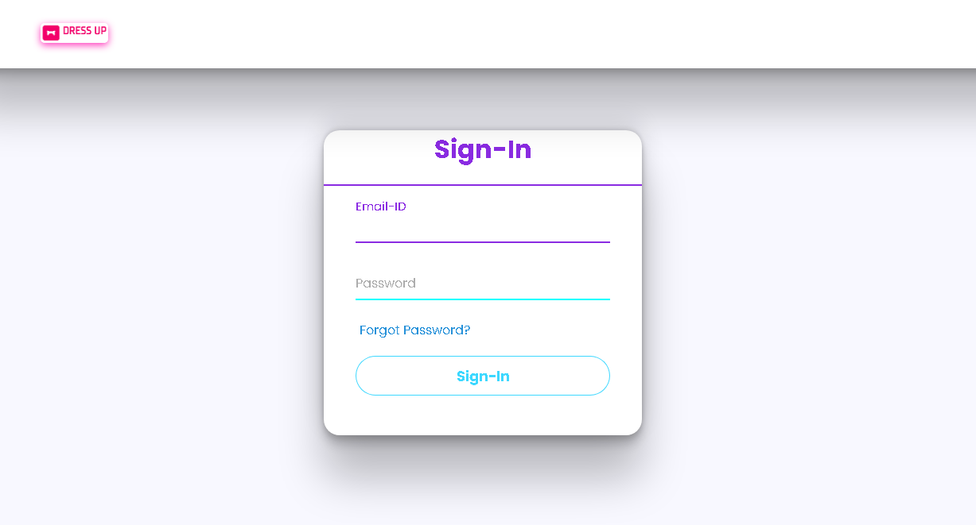
SNAPSHOTS
LOGIN PAGE :

Slide 15
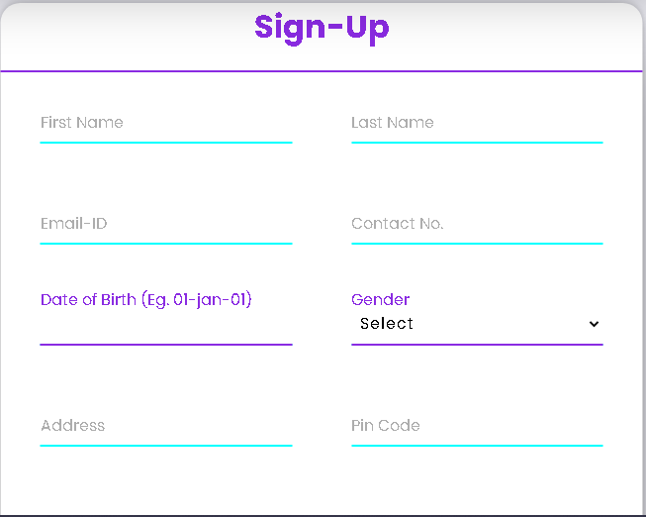
SNAPSHOTS
SIGN UP PAGE :

Slide 16
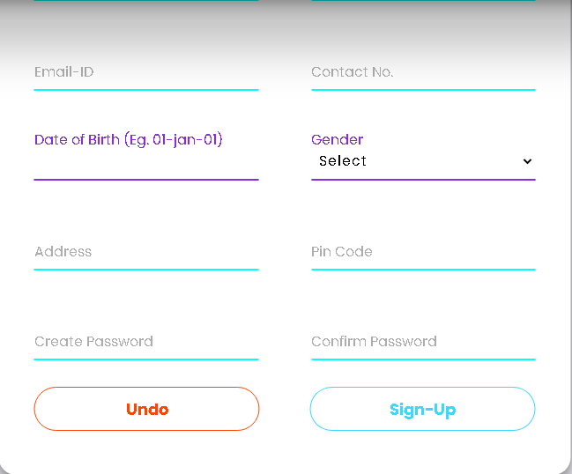
SNAPSHOTS
SIGN UP PAGE :

Slide 17
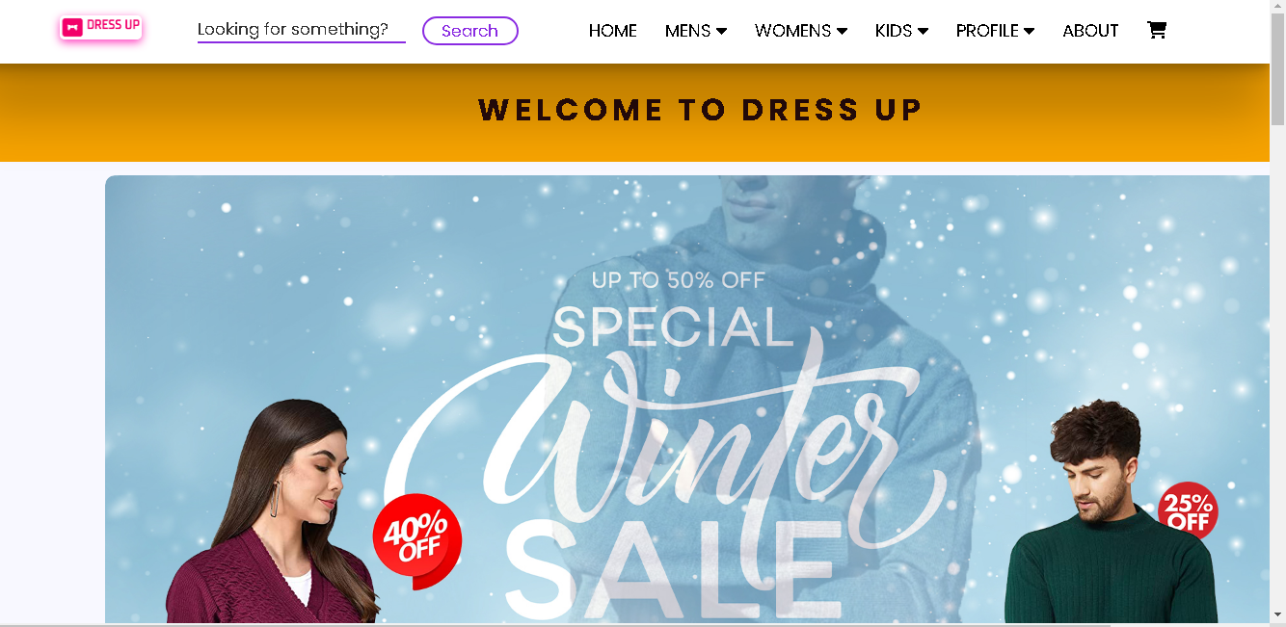
SNAPSHOTS
AFTER SUCCESSFULLY LOGIN :

Slide 18
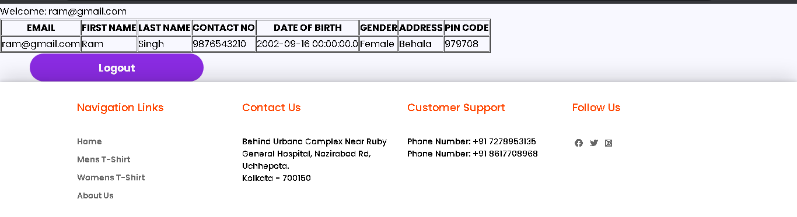
SNAPSHOTS
PROFILE:

Slide 19
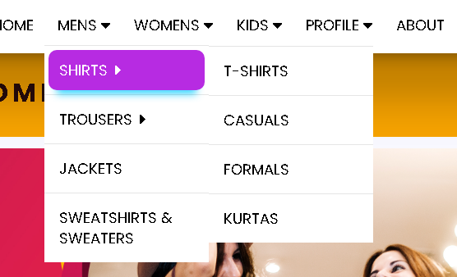
SNAPSHOTS
PRODUCT VIEW:

Slide 20
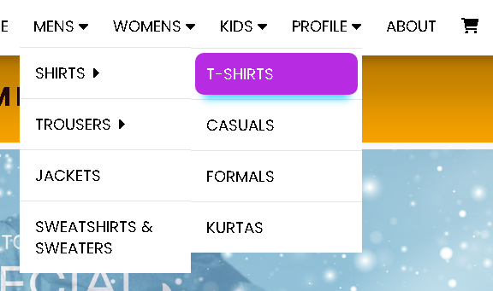
SNAPSHOTS
PRODUCT VIEW:

Slide 21
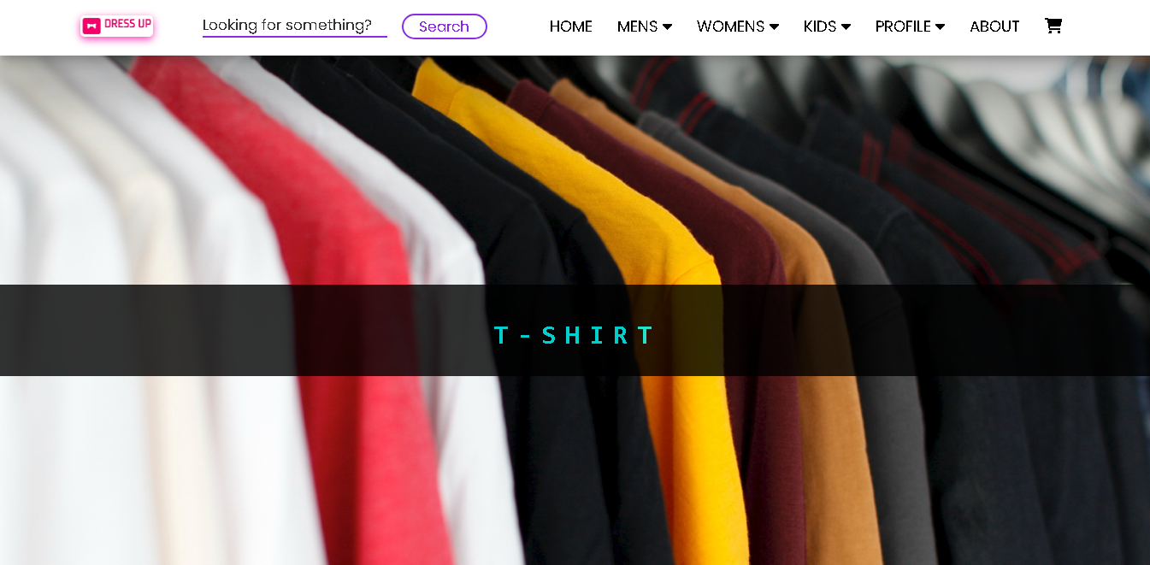
SNAPSHOTS
PRODUCT VIEW:

Slide 22
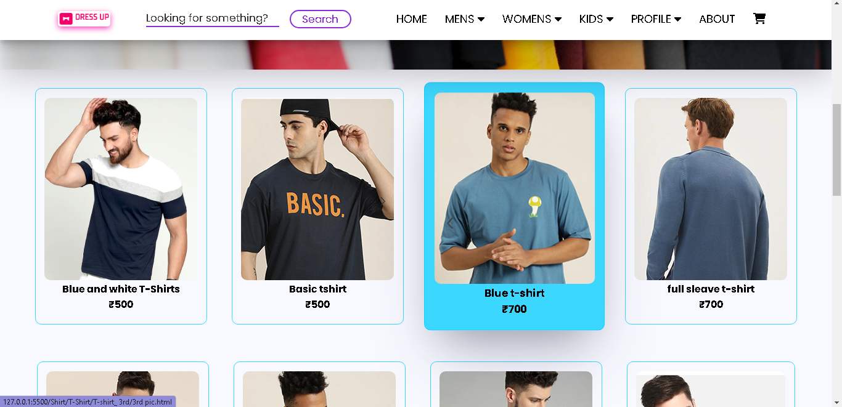
SNAPSHOTS
PRODUCT VIEW:

Slide 23
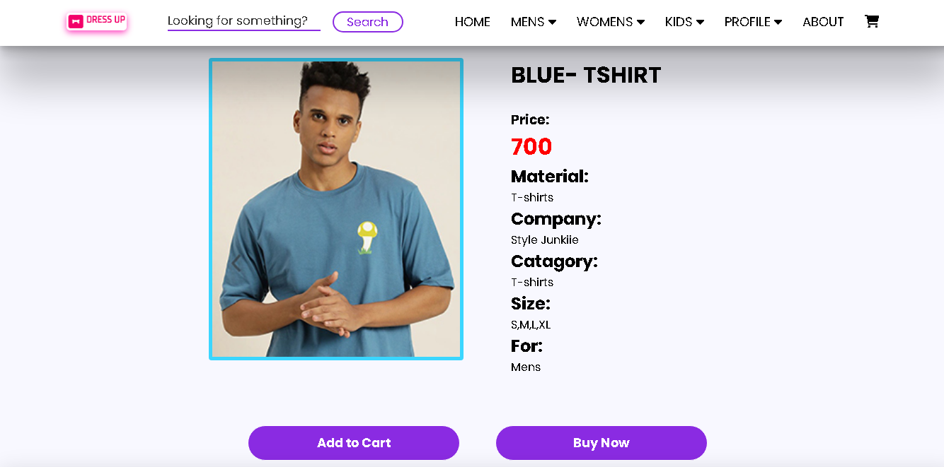
SNAPSHOTS
PRODUCT VIEW:

